Slide 1
Data Modelling

Slide 2
Relational Database Concept
Dr. E. F. Codd proposed the relational model for database systems in 1970.
It is the basis for the relational database management system (RDBMS).
The relational model consists of the following:
Collection of objects or relations
Set of operators to act on the relations
Data integrity for accuracy and consistency
Notes:
Relational Model
The principles of the relational model were first outlined by Dr. E. F. Codd in a June 1970 paper titled “A Relational Model of Data for Large Shared Data Banks.” In this paper, Dr. Codd proposed the relational model for database systems.
The common models used at that time were hierarchical and network, or even simple flat-file data structures. Relational database management systems (RDBMS) soon became very popular, especially for their ease of use and flexibility in structure. In addition, a number of innovative vendors, such as Oracle, supplemented the RDBMS with a suite of powerful application development and user products, providing a total solution.
Components of the Relational Model
Collections of objects or relations that store the data
A set of operators that can act on the relations to produce other relations
Data integrity for accuracy and consistency
For more information, see An Introduction to Database Systems, Eighth Edition (Addison-Wesley: 2004), written by Chris Date.

Slide 3


Definition of a Relational Database
A relational database is a collection of relations or two-dimensional tables.
When designing a database to store information about employees, you create several tables to store different pieces of information about your employee.
Oracle
server
Table name: EMPLOYEES
Table name: DEPARTMENTS
…
…
Notes:
Definition of a Relational Database
A relational database uses relations or two-dimensional tables to store information.
For example, you might want to store information about all the employees in your company. In a relational database, you create several tables to store different pieces of information about your employees, such as an employee table, a department table, and a salary table.

Slide 4
Models - Purpose
Models help communicate the concepts that are in people’s minds.
They can be used to do the following:
Communicate
Categorize
Describe
Specify
Investigate
Evolve
Analyze
Imitate

Slide 5
Models - Purpose
The objective of data modelling is to produce a model that
fits a multitude of these purposes,
can be understood by an end user,
and contains sufficient detail for a developer to build a database system.

Slide 6

Data Models (The Cornerstone of Design)
Model of system in client’s mind
Entity model of client’s model
Table model of entity model
Oracle
server
Tables on disk
Notes:
Data Models
Models are a cornerstone of design. Engineers build a model of a car to work out any details before putting it into production. In the same manner, system designers develop models to explore ideas and improve the understanding of database design.

Slide 7
Data Models (The Cornerstone of Design)
Model of system in client’s mind
Logical Model
Physical Model
Oracle
server
Tables on disk
Notes:
Data Models
Models are a cornerstone of design. Engineers build a model of a car to work out any details before putting it into production. In the same manner, system designers develop models to explore ideas and improve the understanding of database design.

Slide 8
Database Design – Starts at Conceptual Level
Figuring out what information purposes the database is to serve
What questions do the users need to be able to ask of the database?
What pieces of data make up this information? What type of data is it?
What things these pieces of data describe?
How the things we want to store data about can be linked together to provide the information needed?
Result is the Logical Data Model

Slide 9
Conceptual/Logical Data Modelling
Concerned with
What data exists ?
What data is needed in proposed system?
What is the most efficient way of organising it?
Data Modelling Involves
Analysis of data in organisations, departments, branches, processes etc.
Capture of all the data uses
Identifying components of data and relationships between them
Organising it into an efficient structure
Constructing a model of the data requirements of the organisation

Slide 10
Database Modeling and Implementation Process
Analysis
Entity Relationship Design
(Logical)
Relational Model
(Logical/ Physical)
Relational DBMS
(Physical)

Slide 11
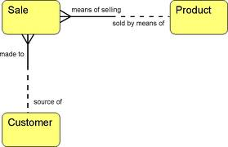
The Entity-Relationship Model
Expressed in terms of:
Entities involved (things about which data is to be stored)
Relationships (or associations) among those entities and
Attributes (properties) of both the entities and their relationships

Slide 12
Entity
Entity
THING or OBJECT of interest to the organization being modeling
E.g. person, place, object, event, concept
Something about which data needs to be stored to fulfill some function
Possible Entities
Obvious physical things,
Persons, places, objects e.g. Customer, Student, Course, products
Transactions or events
Orders, Sales, Hospital Admissions, reservation
Concepts
Plan, Schedule, Account, Course, Fund

Slide 13
Instance
An instance of an entity is a single occurrence of an entity
It describes, for example, one particular customer or product
E.g. The student John Browne is an instance of the Student entity
An entity type is described just once (using metadata) in a database (using your Create Table)
Many instances of that entity type may be represented by data stored in the database
e.g. – there is one EMPLOYEE entity type in most organizations, but there may be hundreds of instances of this entity stored in the database
Notes:
Entity is a template or blueprint – defines structure
Instance is a filled in version of template
E.g. students within college

Slide 14
Entity and Entity Instances
Entity is a blueprint all instances are based on
Betty Arnold
John Taylor
Lisa Simmons
Bill Macy
Instance of entity
Student

Slide 15
Entities and Entity Instances
entity
Student ID | Last Name | First Name
2144 | Arnold | Betty
3122 | Taylor | John
3843 | Simmons | Lisa
9844 | Macy | Bill
2837 | Leath | Heather
2293 | Wrench | Tim
instance
Each Instance must have a unique identifier – called the primary key

Slide 16
Entities and Entity Instances
So what are we doing when building an ERD?
We are defining the structure of entities and the pattern of relationships between them
When we implement that structure and pattern in a physical database then we can populate it with instances of the entity

Slide 17
So why build an ERD?
It is implementation independent
You can implement the same conceptual model in any relational database (SQL Server, Oracle etc.)
There may be small implementation differences (e.g. types) but the structure and relationships will be the same

Slide 18
Attributes
An entity is represented by a set of attributes,
Descriptive properties possessed by all members of an entity set.
Attribute of an entity
pieces of data we want to store about an entity
a descriptive property or characteristic of an entity
student = (student-id, student-name, student-address, student-email)
Only want to record attributes that are of significance to the organisation
The value of an attribute is the value of that attribute for a particular entity occurrence (or instance)
“John Browne” is the value of StudentName attribute
Notes:
Entity is a thing we want to store data about – we need to identify the specific pieces of data we want to store about each instance

Slide 19
Entities and Entity Instances
attributes
Student ID | Last Name | First Name
2144 | Arnold | Betty
3122 | Taylor | John
3843 | Simmons | Lisa
9844 | Macy | Bill
2837 | Leath | Heather
2293 | Wrench | Tim
attribute values

Slide 20
Identifying Instances of Entities
Instances are identified through keys
An entity can have more than one key
The primary key to an entity is an attribute or set of attributes that uniquely identify each occurrence of the entity
Must be unique for each occurrence of an entity
Must always have a value
e.g. students are always assigned a number as soon as they register
Should not contain an attribute whose value is likely to change
e.g. using name or telephone number

Slide 21
Entities and Entity Instances
entity
Student ID | Last Name | First Name
2144 | Arnold | Betty
3122 | Taylor | John
3843 | Simmons | Lisa
9844 | Macy | Bill
2837 | Leath | Heather
2293 | Wrench | Tim
instance
Each Instance must have a unique identifier – called the primary key

Slide 22
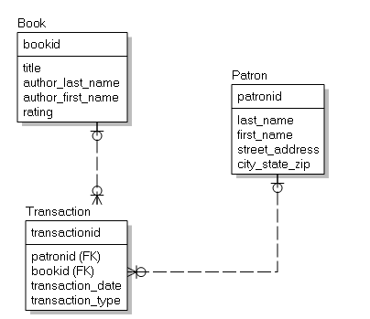
ERD - Library
Primary Key: all items above the line
Foreign Key: (FK) after relevant column

Slide 23
How do you create a model? Step 1
Discover the entities about which you need to store data
Conduct Interviews and Document analysis
Ask what things they would like to capture, store, produce information about
Study forms, files, reports
Identify key words
Some identify event entities e.g. orders, payments etc.
Look for relationships between things
Give entities meaningful names
Name with NOUNS
May include adjectives e.g. customer order, stock order
Define them in business terms
Notes:
Know enough now to read a data model and interpret them
Key words – pay attention to key words in discussion e.g. clients., members, stock

Slide 24
Our Example from Last Week
A local county council organises football competitions for school children.
Competitions are held on different dates for different age groups with fees and prizes. Each competition has an ID.
There are lots of teams who compete. Each team has an ID, a name and an age group.
What are the entities?

Slide 25
How do you create a model? – Step 2
For each entity
Identify its attributes
Decide on a name for each (starting with lowercase)
Identify the correct data type and size required for each

Slide 26
Data types
Each value manipulated by Oracle has a Datatype.
There are 4 main types of data
Characters or character strings (CHAR, VARCHAR2)
Numeric Data (NUMBER)
Data and time (DATE)
Binary (RAW, BLOB, BFILE etc.)
Each column in a relational database can hold only one type of data
You cannot mix data types within a column.
At design stage you need to clearly identify the data type so that it can be correctly implemented in a physical database when it is built from the design

Slide 27
Data types
Different types of data have different types of characteristics, the purpose of which is to efficiently store data.
By defining your data structures efficiently you are facilitating improved efficiency in your application programming.
Different data types offer several advantages:
Columns of a single type produce consistent results.
For example, DATE data type columns always produce date values.
You cannot insert the wrong type of data into a column.
For example, columns of data type DATE will prevent NUMBER type data from being inserted.

Slide 28
Numeric data types
The NUMBER data type is used to store negative, positive, integer, fixed-decimal, and floating-point numbers.
NUMBER(n) where n is an integer value.
This denotes a number n digits long.
E.g. Phone_no NUMBER(12)

Slide 29
Numeric data types
To store decimal numbers we still use Number but we must supply
Precision is the total number of significant digits in the number, both to the left and to the right of the decimal point.
Scale is the total number of digits to the right of the decimal point.
NUMBER (n,m) where n, m are integer values.
This denotes a decimal number, with n digits in total, m after the decimal place.
E.g.
CostPrice NUMBER(7,2)
It basically means 7 numbers, 2 of which are after the decimal place can be stored in the column CostPrice
Allows the column to hold values up to 99999.99

Slide 30
Character data types
CHAR
This denotes a single character.
Example: GENDER CHAR
CHAR(n) where n is an integer value.
This denotes a n-character fixed length string.
If data is inserted that does not have the required number, the remaining characters are padded with blanks.
Alphanumeric characters are allowed.
Example:
StudentNo CHAR(9)
If we insert the value 123 what will actually be stored is 123 plus 6 spaces – ‘123 ‘
When inserting values into character columns, surround the value by single quotes.

Slide 31
Character data types
VARCHAR2 is our preferred datatype for character data longer than a single character
VARCHAR2(n) where n is an integer value.
This denotes a variable length string, with a maximum length of n.
If the data are smaller than the specified size, only the data value is stored, and trailing spaces are not added to the value.
Alphanumeric characters are allowed.
Example: StudentName VARCHAR2(30).
When inserting values into character columns, surround the value by single quotes.
Example:
StudentNo VARCHAR2(9)
If we insert the value 123 what will actually be stored is 123 – ‘123’

Slide 32
Date Time Datatype
DATE
This denotes a date AND TIME field.
It holds the date and time correct to a second.
The datatype DATE suffices for most purposes.
Stores a value of centuries down to whole seconds, but cannot store fractions of a second.
’21-AUG-2013 17:25:30’ is a valid value
When comparing dates, remember that two dates with the same day may be different
The hours, minutes or seconds may differ
So we will need to do some work on date fields in advance of comparing to ensure our comparisons make sense
We can indicate the formal we want dates output in e.g. ‘DD-MMM-YY’ or DD-MM-YY or YY-MM-DD
E.g. ‘01-JAN-10’ or 01-01-10 or 10-01-01

Slide 33
Date Time Datatype
The TIMESTAMP data type is an extension of the DATE data type which allows fractions of a second.
It stores the year, month, and day of the DATE data type plus hour, minute, and second values as well as the fractional second value.
For example, TIMESTAMP(3) allows 3 digits after the whole seconds, allowing values down to milliseconds to be stored.

Slide 34
Data Types
Data Type | Description
VARCHAR2(size) | Variable-length character data
CHAR(size) | Fixed-length character data
NUMBER(pgs.) | Variable-length numeric data
DATE
LONG | Variable-length character data (up to 2 GB)
CLOB | Character data (up to 4 GB)
RAW and LONG RAW | Raw binary data
BLOB | Binary data (up to 4 GB)
BFILE | Binary data stored in an external file (up to 4 GB)
ROWID | A base-64 number system representing the unique address of a row in its table
Notes:
Data Types
When you identify a column for a table, you need to provide a data type for the column. There are several data types available:

Slide 35
Datetime Data Types
You can use several datetime data types:
Data Type | Description
DATE | Date and time values
TIMESTAMP | Date with fractional seconds
INTERVAL YEAR TO MONTH | Stored as an interval of years and months
INTERVAL DAY TO SECOND | Stored as an interval of days, hours, minutes, and seconds
Notes:
Other Datetime Data Types
Note: These datetime data types are available with Oracle9i and later releases. For detailed information about the datetime data types, see the topics “TIMESTAMP Datatype,” “INTERVAL YEAR TO MONTH Datatype,” and “INTERVAL DAY TO SECOND Datatype” in the Oracle SQL Reference.

Slide 36
Where are the Booleans?
Oracle SQL does not support a Boolean datatype.
You have to use a workaround.
You can mimic Booleans by using a single character CHAR(1) or a single number NUMBER(1)

Slide 37




What Is a LOB?
LOBs are used to store large unstructured data such as text, graphic images, films, and sound waveforms.
“Four score and seven years ago our fathers brought forth upon this continent, a new nation, conceived in LIBERTY, and dedicated to the proposition that all men are created equal.”
Movie (BFILE)
Text (CLOB)
Photo (BLOB)
Notes:
LOB: Overview
A LOB is a data type that is used to store large, unstructured data such as text, graphic images, video clippings, and so on. Structured data, such as a customer record, may be a few hundred bytes, but even small amounts of multimedia data can be thousands of times larger. Also, multimedia data may reside in operating system (OS) files, which may need to be accessed from a database.
There are four large object data types:
BLOB represents a binary large object, such as a video clip.
CLOB represents a character large object.
NCLOB represents a multibyte character large object.
BFILE represents a binary file stored in an OS binary file outside the database. The BFILE column or attribute stores a file locator that points to the external file.
LOBs are characterized in two ways, according to their interpretations by the Oracle server (binary or character) and their storage aspects. LOBs can be stored internally (inside the database) or in host files. There are two categories of LOBs:
Internal LOBs (CLOB, NCLOB, BLOB): Stored in the database
External files (BFILE): Stored outside the database

Slide 38
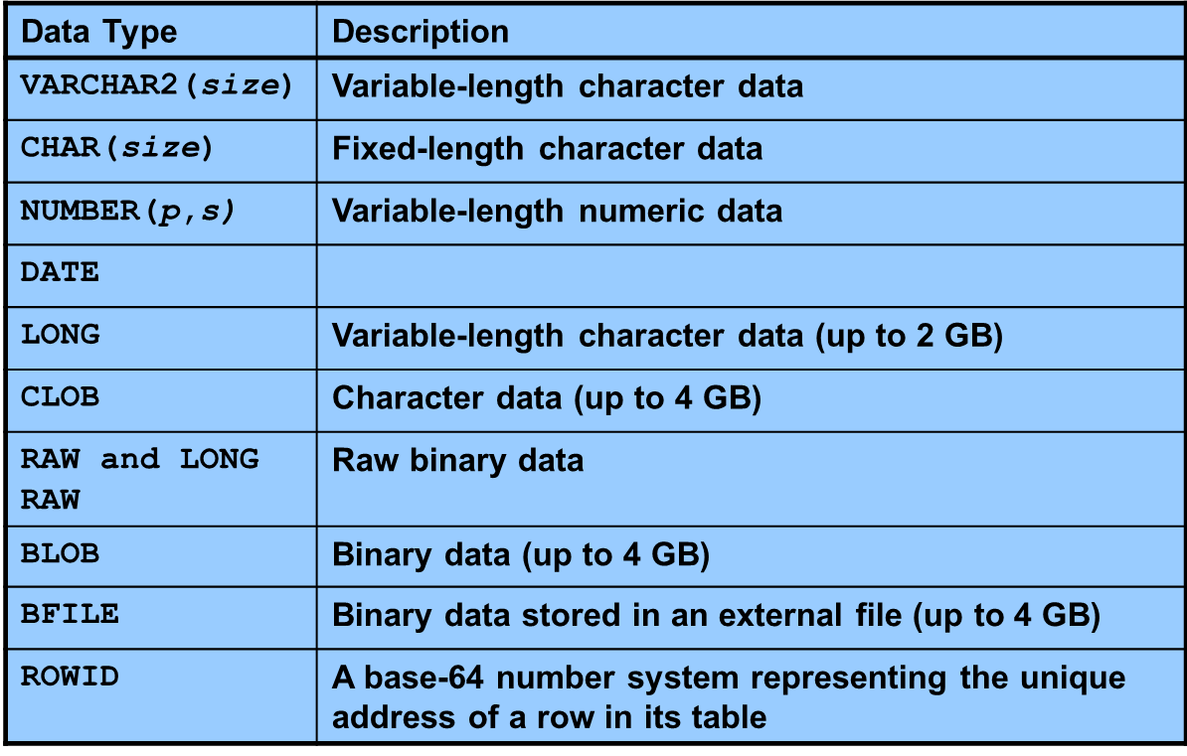
Datatypes Oracle

Slide 39
Example from Last Week
Each competition has
a unique numeric ID (5 digits)
a name (up to 50 characters)
an entrance fee (which could store values up to 999.99),
A prize (which could store values up to 9999.99) and
the date on which the competition will happen.
Each team has
a unique numeric ID (5 digits)
a name (up to 50 characters)
an age group (2 digits).
What are the attributes and their datatypes?

Slide 40
How do you create a model? Step 3
Identify relevant value constraints on the attributes we can define at this stage

Slide 41
Constraints
Constraints are rules that the data must follow to belong to a given entity.
Constraints are rules that the data must follow to be removed from a given entity.
Constraints enforce rules at entity level.

Slide 42


Slide 43
Constraints
Ensures that whoever uses your data can be confident that the data will be consistent.

Slide 44
Constraints
Primary Key Constraints
ENTITY Integrity
Foreign Key Constraints
REFERENTIAL Integrity
Value Constraints
Define
if NULL values are disallowed
if UNIQUE values are required
and if only certain set of values are allowed in a column.
Enforce DOMAIN INTEGRITY
In addition to the datatype

Slide 45
NULL and NOT NULL
What is NULL?
Null is a non-value
It is not zero
It is not blank
NULL is a special name to denote a valueless column in a row.
If the column must contain a non-null value, the constraint ‘NOT NULL’ should be put on it.
This will prevent a user from adding a row that has no value for this column
E.g. there is no sense in adding a student without a name
There is no sense in adding a stock item without a description.
The default is NULL
i.e. unless you specify NOT NULL, nulls will be allowed.

Slide 46
UNIQUE constraint
UNIQUE
This allows the column value to be checked against all other values in that column in the table.
This constraint can be used even if the column allows nulls.
E.g. an e-mail address is not necessary, but if it is present, it must be unique: no other member can have the same e-mail address.

Slide 47
CHECK
Defines a condition that each row must satisfy
This allows the column value to be checked
against a range of values
E.g. < value, > value, between n and m, etc.
or selection of values.
E.g. IN (‘Monday’,’Tuesday’,’Wednesday’)
There is a way of doing more extensive checking, but CHECK protects our table from having a lot of bad data.
A single column can have multiple CHECK constraints that refer to the column in its definition.

Slide 48
Comparison Conditions
Operator | Meaning
= | Equal to
> | Greater than
>= | Greater than or equal to
< | Less than
<= | Less than or equal to
<> | Not equal to
BETWEEN ...AND... | Between two values (inclusive)
IN(set) | Match any of a list of values
LIKE | Match a character pattern
IS NULL | Is a null value
Notes:
Comparison Conditions
Comparison conditions are used in conditions that compare one expression to another value or expression. They are used in the WHERE clause in the following format:
Syntax
... WHERE expr operator value
Example
... WHERE hire_date = '01-JAN-95'
... WHERE salary >= 6000
... WHERE last_name = 'Smith'
An alias cannot be used in the WHERE clause.
Note: The symbols != and ^= can also represent the not equal to condition.

Slide 49
Logical Operators
Operator | Meaning
AND | Returns TRUE if both component conditions are true
OR | Returns TRUE if either component condition is true
NOT | Returns TRUE if the following condition is false
Notes:
Logical Conditions
A logical condition combines the result of two component conditions to produce a single result based on those conditions, or it inverts the result of a single condition. A row is returned only if the overall result of the condition is true.
Three logical operators are available in SQL:
AND
OR
NOT
All the examples so far have specified only one condition in the WHERE clause. You can use several conditions in one WHERE clause using the AND and OR operators.

Slide 50
Rules of Precedence
Operator | Meaning
1 | Arithmetic operators
2 | Concatenation operator
3 | Comparison conditions
4 | IS [NOT] NULL, LIKE, [NOT] IN
5 | [NOT] BETWEEN
6 | Not equal to
7 | NOT logical condition
8 | AND logical condition
9 | OR logical condition
You can use parentheses to override rules of precedence.
Notes:
Rules of Precedence
The rules of precedence determine the order in which expressions are evaluated and calculated. The table lists the default order of precedence. You can override the default order by using parentheses around the expressions that you want to calculate first.

Slide 51
Our Example
Each competition must have
a unique numeric ID (5 digits)
a name (up to 50 characters) – this must be unique
an entrance fee (must be less than100 euro)
a prize (must be less than1500.00euro)
the date on which the competition will happen.
None of these allow null values.
Each team must have
a unique numeric ID (5 digits)
a name (up to 50 characters) – this must be unique
an age group (2 digits) (must be less than 20)
None of these allow null values
What are the value constraints needed?

Slide 52
How do you create a model? – Step 4
For each entity
Identify which attribute will uniquely identify it
PRIMARY KEY
Picking Keys
Value of key should not change over lifetime of entity
Value of key cannot be null
Value must be valid
Possibilities
Codes used in business
Serial codes, alphabetic codes
Invent a key
Combine a number of attributes
Invent a new attribute for the key

Slide 53
Primary Keys
A candidate key is a key that could potentially become a primary key
Any candidate key that is not selected to be a primary key is termed an alternate key
A key consisting of a group of attributes is called a compound or concatenated key

Slide 54
Key Constraints – Primary Key
Is an attribute or a set of attributes that uniquely identify a specific instance of an entity.
Every entity in the data model must have a primary key whose values uniquely identify instances of the entity.
Enforce entity integrity by uniquely identifying entity instances.

Slide 55
Key Constraints – Primary Key
To qualify as a primary key for an entity, an attribute must have the following properties:
it must have a non-null value for each instance of the entity
the value must be unique for each instance of an entity
the values must not change or become null during the life of each entity instance.

Slide 56
Key Constraints
Sometimes an entity will have more than one attribute that can serve as a primary key.
Any key or minimum set of keys that could be a primary key is called a candidate key.
Once candidate keys are identified, choose one, and only one, primary key for each entity.
Choose the identifier most commonly used by the user as long as it conforms to the properties required of a primary key.
Candidate keys which are not chosen as the primary key are known as alternate keys.

Slide 57
Key Constraints – Primary Key
Let's assume that for each employee in an organization there are three candidate keys:
Employee ID, PRSI Number, and Name.
Name is the least desirable candidate.
Even for a small company it would not be unusual for two people to have exactly the same name, more unusual for a large company.
There is the possibility that an employee's name could change because of marriage.
Employee ID would be a good candidate as long as each employee were assigned a unique identifier at the time of hire.
PRSI number could also work since every employee is required to have one before being hired.

Slide 58
Our Example
Each competition must have
a unique numeric ID (5 digits)
a name (up to 50 characters) – this must be unique
an entrance fee (must be less than100 euro)
a prize (must be less than1500.00euro)
the date on which the competition will happen.
None of these allow null values.
Each team must have
a unique numeric ID (5 digits)
a name (up to 50 characters) – this must be unique
an age group (2 digits) (must be less than 20)
None of these allow null values
What are the primary keys?

Slide 59
How do you create a model? Step 5
Identify relationships between entities
A relationship is a link or an association between two entities which is meaningful for the organisation
e.g. A Customer ‘places’ an Order
A relationship is a natural business association that exists between one or more entities
May represent an event
May represent logical affinity
Relationships usually arise because of
association - a Customer ‘places’ an Order
structure - an Order ‘consists’ of Order-Lines
All relationships that are usable only involve two entities
Name relationships with VERBS.

Slide 60
Relationships
We relate entities to each other in quantitative terms
i.e. in terms of the quantity of instances of one entity that is related to a quantity of instances of the second.
All relationships are bi-directional so cardinality must be defined in both directions for every relationship
Cardinality defines the minimum and maximum number of instances in one entity that may be related instance(s) of the other entity
Also called complexity or degree of the relationship
Examples
A customer places one or more orders
An order is placed by one or more customers
An order consists of one or more products
A product appears on zero, one or more orders
A student enrols on one or more modules
Notes:
Bold, underlined verb phrases define business relationships between two entities

Slide 61
How do you create a model? Step 5
Define the type and optionality of each relationship
How many instances of each entity are involved ?
Does the relationship have to exist for all instances?
Define the Cardinality/Complexity/Degree of relationships
Need to ask questions about the relationship
Must there a customer exist for every order ?
Must an order exist for every customer ?
Must an order always include a product ?
How many products can an order include ?
Must a product appear on an order ?
Notes:
Entities don’t exist in isolation. The things they represent interact with and impact one another to support business mission so we introduce the concept of a relationship

Slide 62


Suppose we have a colony of highly evolved fish living in Tahiti
They have developed a culture of their own which is slightly unusual and they have laws which enforce their culture

Slide 63
Cardinality
They value bicycles highly.
Each fish is allowed to have a bicycle.
BUT they may only have one,
AND they may choose not to have a bicycle.
One fish owns zero or one bicycle
zero-to-one relationship - any occurrence of the first entity is related to at maximum one occurrence of the second entity.
Owns
One Bike
One Fish
Owns
No Bike
One Fish

Slide 64
Relationships work both ways
We need also consider how the relationship works in reverse
How are bicycles related to fish.
In the fish culture a bicycle cannot exist unless it owned by a fish.
So each bicycle must belong to a fish and can only belong to one fish
Each bicycle belongs to exactly one fish
one-to-one relationship - any occurrence of the first entity is related to at maximum one and only one occurrence of the second entity.
Belongs to
One Bike
One Fish

Slide 65

Cardinality
All fish are required to have a top hat.
They must always be in possession of a top hat.
They are allowed to have more than one top hat.
Each fish can own many top hats
one-to-many relationship - any occurrence of the first entity is related to at least one occurrence of the second entity but may be related to many instances of the second
Owns
One Fish
Many Top Hats

Slide 66
Cardinality
We need also consider how the relationship works in reverse
How are top hats related to fish?
In the fish culture a top hat cannot exist unless it owned by a fish.
So each top hat must belong to a fish and can only belong to one fish
Each top hat belongs to exactly one fish
one-to-one relationship - any occurrence of the first entity is related to one and only one occurrence of the second entity
Belongs to
One Top Hat
One Fish

Slide 67

Cardinality
All fish are required to have a cane.
They must always be in possession of a cane.
A cane cannot exist unless it belongs to a fish.
Each fish has to own one cane, each cane belongs to exactly one fist
Owns
One Fish
One Cane

Slide 68
Foreign Key
Creating a relationship on the diagram results in the addition of FKs (if they do not already exist)
When one table needs to be related to another table, you must include a common attribute(s).
The common attribute(s) will be the primary key in one table.
The atrribute(s) in the related table is referred to as the foreign key.
The foreign key in a table can then be used as a primary key to access the record in the related table when needed.
It also helps enforce data integrity (ensuring values cannot be input that do not exist)

Slide 69
Foreign Key
A foreign key value must match an existing value in the parent table or be NULL.
Foreign keys are based on data values and are purely logical, rather than physical, pointers.

Slide 70
Each fish has a unique identifier
In the hat table one of the attributes will be the identifier of the fish that owns it (THIS IS THE FOREIGN KEY)
quango
Owns
One Fish
Many Top Hats

Slide 71
Cardinality
The fish love Quangos (quasi-autonomous non-governmental organisations).
These Quangos influence all areas of their culture and are used to make representation to the Fish government.
In the Fish culture a fish must participate in many Quangos
Each Quango must have many fish participants
many to many relationship - two entities are related to each other by one to many relationships
Many Fish
One Quango
Involves
Participate in
One Fish
Many Quangos

Slide 72
Many:Many
How do we store the details of each Quango membership?
Does this belong with the Fish or the Quango?

Slide 73
Many:Many
Often with many to many relationships there is information associated with the relationship that cannot be attached sensibly to either entity.
Attaching data to one or other entity results in repeating data
YOU CANNOT HOLD ‘ARRAY’s in a relational table.

Slide 74
Resolving Many:Many
Introduce a Weak Entity
The primary key of a weak entity is always the combination of the primary keys of the entities in the relationship it is resolving
One Fish
One Quango
Many Memberships

Slide 75
Weak Entity
Why is it weak?
It cannot exist independently of the other entities involved

Slide 76
Data Modeling Concepts: Foreign Key
A primary key of an entity that is used in another entity to identify instances of a relationship.
A foreign key is a primary key of one entity that is contributed to (duplicated in) another entity to identify instances of a relationship.
A foreign key always matches the primary key in the another entity
A foreign key may or may not be unique (generally not)
The entity with the foreign key is called the child.
The entity with the matching primary key is called the parent.
Notes:
Teaching Notes
Foreign keys are what make a relational database relational.

Slide 77
Data Modeling Concepts: Parent and Child Entities
Parent entity
An entity that contributes one or more attributes to another entity, called the child.
In a one-to-many relationship the parent is the entity on the "one" side.
Child entity
An entity that derives one or more attributes from another entity, called the parent.
In a one-to-many relationship the child is the entity on the "many" side.
Notes:
Teaching Notes
These concepts are illustrated on the next slide.

Slide 78
Data Modeling Concepts: Non identifying Relationships
A relationship where each participating entity has its own independent primary key
Primary key attributes are not shared.
The entities are called strong entities
Max Cardinality =1
Max Cardinality =many
SCHOOL
schoolID
schoolName
LECTURER
leccturerID
schooID (FK)
lecturerName
A parent entity always has a max cardinality of “many” children
Parent Entity
Child Entity
Notes:
No additional notes.

Slide 79
Data Modeling Concepts: Non identifying Relationships
In this case a lecturer only works for one school
So if we have school with an schoolid=1, schooname=“Computing”
That has two lecturers Deirdre Lawless and Deirdre Lillis then we need TWO instances of lecturer each with a different lecturerID but the same value for the schoolID attribute.
Max Cardinality =1
Max Cardinality =many
SCHOOL
schoolID
schoolName
LECTURER
lecturerID
schooID (FK)
lecturerName
A parent entity always has a max cardinality of “many” children
Parent Entity
Child Entity
Notes:
No additional notes.

Slide 80
Data Modeling Concepts: Non identifying Relationships
Lecturer 1: lecuterID=1, schoolID=1, lecturerName=“Deirdre Lillis”
Lecturer 2: lectureID=2, schoolID=1, lecturerName=“DeirdreLawless”
ONE instance of school is related to MANY instances of lecturer
Notes:
No additional notes.

Slide 81
Non-Identifying Relationship
When the primary key attributes of the parent are not part of the primary key attributes of the child but is an attribute of the child table.
A good example of this for our football competition would be introducing a manager into the mix
Each team has a manager
Each manager has a unique Id
A manager can manage many teams but each team has only one manager.
managerID will be an attribute of team
it will be a foreign key
It doesn’t define the teams identity
It is non-identifying

Slide 82
Data Modeling Concepts: Identifying Relationships
A relationship in which the parent entity’ key is also part of the primary key of the child entity.
The child entity is called a weak entity.
Max Cardinality =1
Max Cardinality =many
Building
buildingID
Nuildingame
Room
roomID
buildingID (FK)
roomName
In an Identifying Relationship, the primary key of the PARENT entity is added to the primary key of the CHILD
Parent Entity
Child Entity
Notes:
No additional notes.

Slide 83
Data Modeling Concepts: Identifying Relationships
In this case the primary key of the child entity is a compound or composite key (made up of more than one entity)
Max Cardinality =1
Max Cardinality =many
Building
buildingID
Nuildingame
Room
roomID
buildingID (FK)
roomName
In an Identifying Relationship, the primary key of the PARENT entity is added to the primary key of the CHILD
Parent Entity
Child Entity
Notes:
No additional notes.

Slide 84
Data Modeling Concepts: Identifying Relationships
Conceptually in this model a room does not exist unless it is in a building so it depends on building for its identify.
Therefore it must be part of its primary key.
This becomes particularly important when resolving logical to physical models
Notes:
No additional notes.

Slide 85
Identifying Relationship
When the existence of a an instance in a child table depends on a row in a parent table.
The Primary Key of the Parent Table must be part of the Childs Primary Key
So in our example for Fish (Parent) and Quango (Parent),
The QuangoMembership table (Child) entity will have the FishID and QuangoID as part of its primary key
We would still refer to these (FIshID and QuangoID) as foreign keys

Slide 86
Difference between Logical and Physical Design
Logical Modelling
Conceptual
Revolves around the needs of the business, not the database, although the needs of the business are used to establish the needs of the database.
Involves gathering information about business processes, business entities (categories of data), and organizational units
It is ok to have many to many relationships

Slide 87
Difference between Logical and Physical Design
Physical
Involves the actual design of a database according to the requirements that were established during logical modelling
Needs to be implementable in the type of database you are working with so we are converting our logical model to a relational data model
Need to resolve the many to many into a series of one to many introducing a weak entity

Slide 88
Our Example
What relationships exist between entities?
Teams enrol in competitions.
A team can enrol in many competitions.
A competition can have many teams.
How do we resolve the Logical to a Physical Design?
Are the relationships identifying or non-identifying?

Slide 89
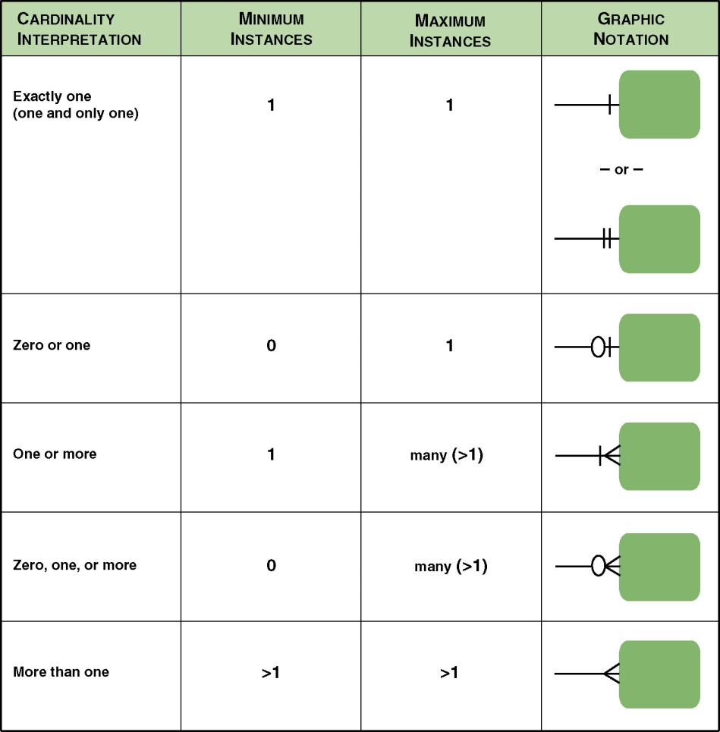

Slide 90
Example
A college contains many departments
Each department can offer any number of courses
Many instructors can work in a department
An instructor can work only in one department
For each department there is a Manager
Each manager can manage only one department
Each instructor can take any number of courses
A course can be taken by only one instructor
A student can enrol for any number of courses
Each course can have any number of students

Slide 91
Step 1: Identify the entities
What are the entities here?
From the statements given, the entities are
College
Department
Course
Instructor
Student
Manager

Slide 92
Additional Information
Each department has a name and a location associated with it
Each course has a name and a duration
Instructors and Students and Managers have first names, last names and phone numbers
Each department, course, instructor, manager, and student have a unique id

Slide 93
Step 2: Identify the attributes and datatypes
For the department entity, attributes are id, name, location
For course entity, attributes are id, course_name, duration
For instructor entity, attributes are id, first_name, last_name, phone
For student entity, attributes are id, first_name, last_name, phone

Slide 94
Step 3: Identify the constraints
Each department must have a name and a location associated with it
Each course must have a name and a duration
Instructors and Students and Managers must have first names, last names and phone numbers

Slide 95
Step 4: Identify the Keys
ID can identify a department uniquely. Hence Department_ID is the key attribute for the Entity "Department".
Course_ID is the key attribute for "Course" Entity.
Student_ID is the key attribute for "Student" Entity.
Instructor_ID is the key attribute for "Instructor" Entity.

Slide 96
Step 5 : Identify the relationships between entities
One department offers many courses. But one particular course can be offered by only one department.
Hence the cardinality between department and course is One to Many (1:N)
One department has multiple instructors . But instructor belongs to only one department.
Hence the cardinality between department and instructor is One to Many (1:N)
One department has only one manager and one manager can manage only one department.
Hence the cardinality is one to one. (1:1)

Slide 97
Step 5 : Identify the relationships between entities
One course can enrol many students and one student can enrol for many courses.
Hence the cardinality between course and student is Many to Many (M:N)
One course is taught by only one instructor. But one instructor teaches many courses.
Hence the cardinality between course and instructor is Many to One (N :1)

Slide 98
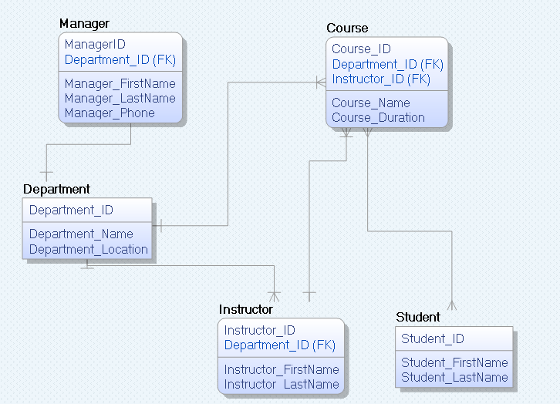
The model

Slide 99
Summary
A good data model is simple.
Data attributes that describe any given entity should describe only that entity.
Each attribute of an entity instance can have only one value.
A good data model is essentially non-redundant.
Each data attribute describes at most one entity.
Look for the same attribute recorded more than once under different names.
A good data model should be flexible and adaptable to future needs.

